Slide 1
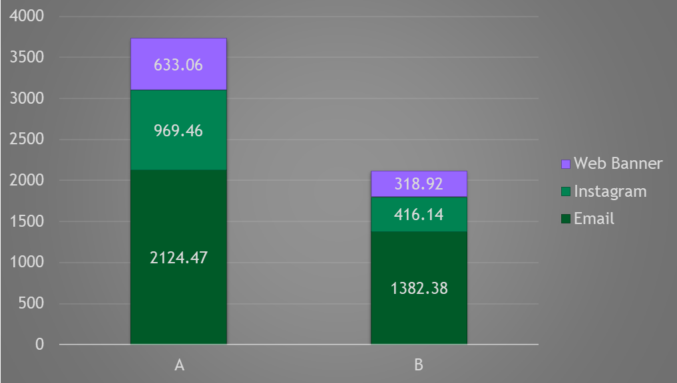
Campaign and message Insights: NewCo
Sum of Sales for New Customers
Recommendation:
Message A is better than B overall, with leading channel being Email. Hence, the ideal combination is Email + A which New co should focus on to enhance sales coming from New customers.

Slide 2
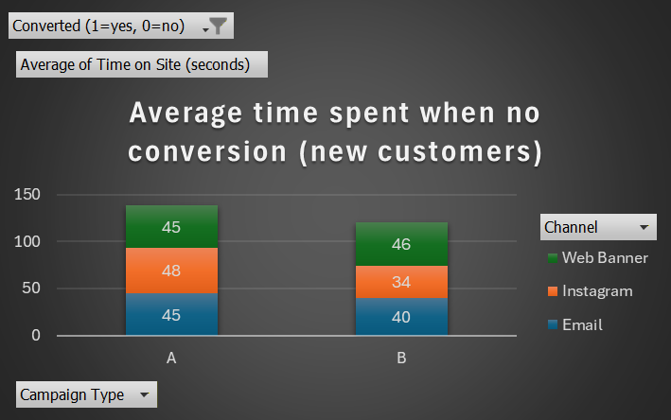
Campaign and message Insights: NewCo
Average time spent by new customers when no conversion
Recommendation:
This indicates new consumers spend most time on message A on an average, and Instagram is where they are spending their highest time (48 seconds), hence focus on Instagram via message A to convert new customers.

Slide 3
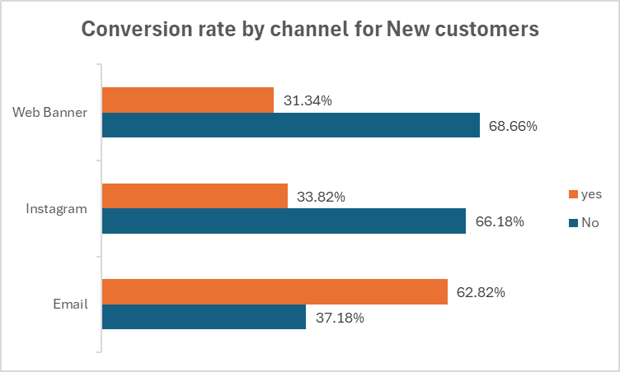
Campaign and message Insights: NewCo
Conversion Rate (by channel )
Recommendation:
If we solely look at conversion Rate, Email has stood first with the highest conversion rate out of all 3 options of channel.

